Slide 1
Vibing Tree
Zachary Deng

Slide 2
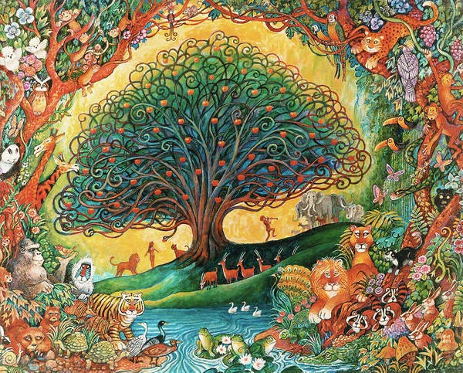

Design
Tree of Knowledge of Good and Evil
At the center
Synthwave
Lake (ocean)
Sunset (no sun)
Also a tree

Slide 3
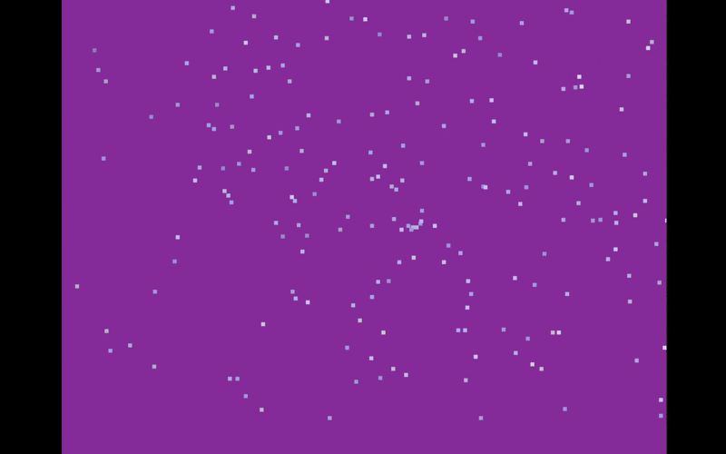
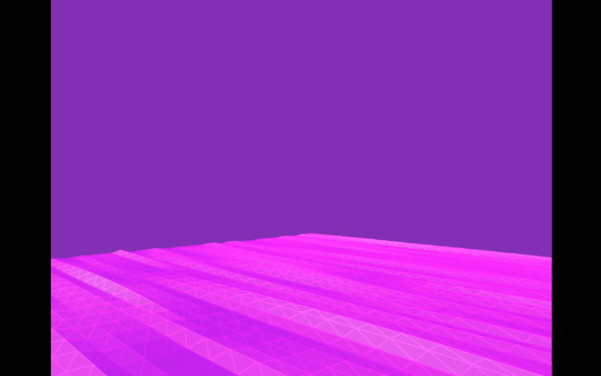

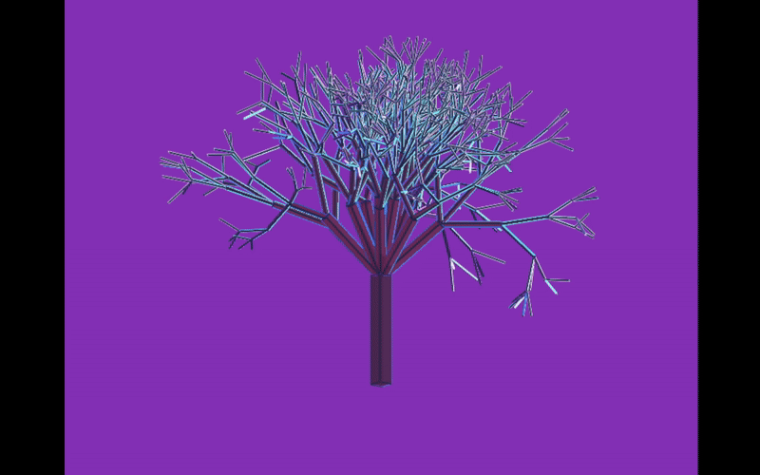
Implementation

Slide 4
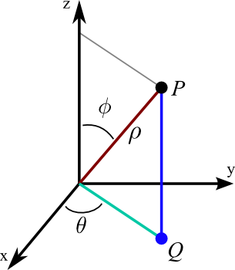
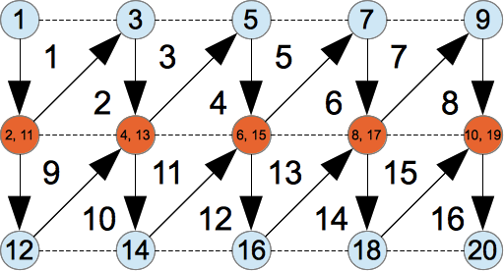
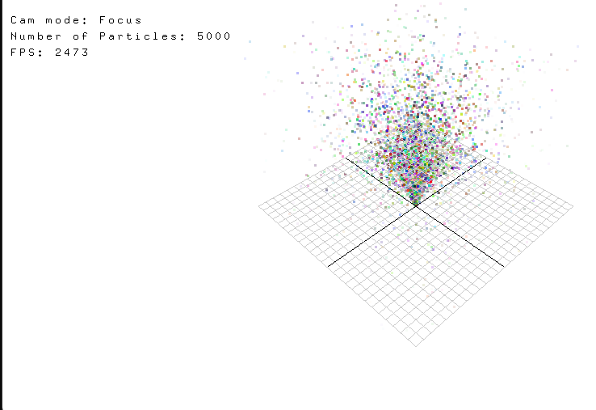
Lessons Learned
Spherical coordinates are useful
VBO/IBO + VAO combo
Use old assignments

Slide 5
Video

Slide 6
